Slide 1
Race Day Agenda
Volunteer Arrival 7:00 AM
Bib/Packet Distribution 7:30-8:30 AM
Welcome 8:30 AM
Pledge 8:35 AM
Star Spangled Banner 8:40 AM
Race Start 9:00 AM
Race Awards Ceremony 10:15 AM
K-9 Demo / Helicopter Tour 11:00 AM
Close 11:30 AM

Slide 2
IMPORTANT NOTES
All Entrances into site will be closed by 8:30am except for TCP N.
Parking lot at HLZ [1] is not for parking! Helicopter will be landing there!
NO Dogs are allowed on site
All 1 Mile Walkers will do only 1 lap around the course. 5K Runners/Ruckers will do 2 laps.
If you want to change your event, let us know before the race!
Park only in designated Parking Zones!
Please bring at least 1 pair of NEW socks for the TMF Sock Drive
Have Fun!
In case of Delays or Cancellation, look to our Facebook page and your email inbox.

Slide 3
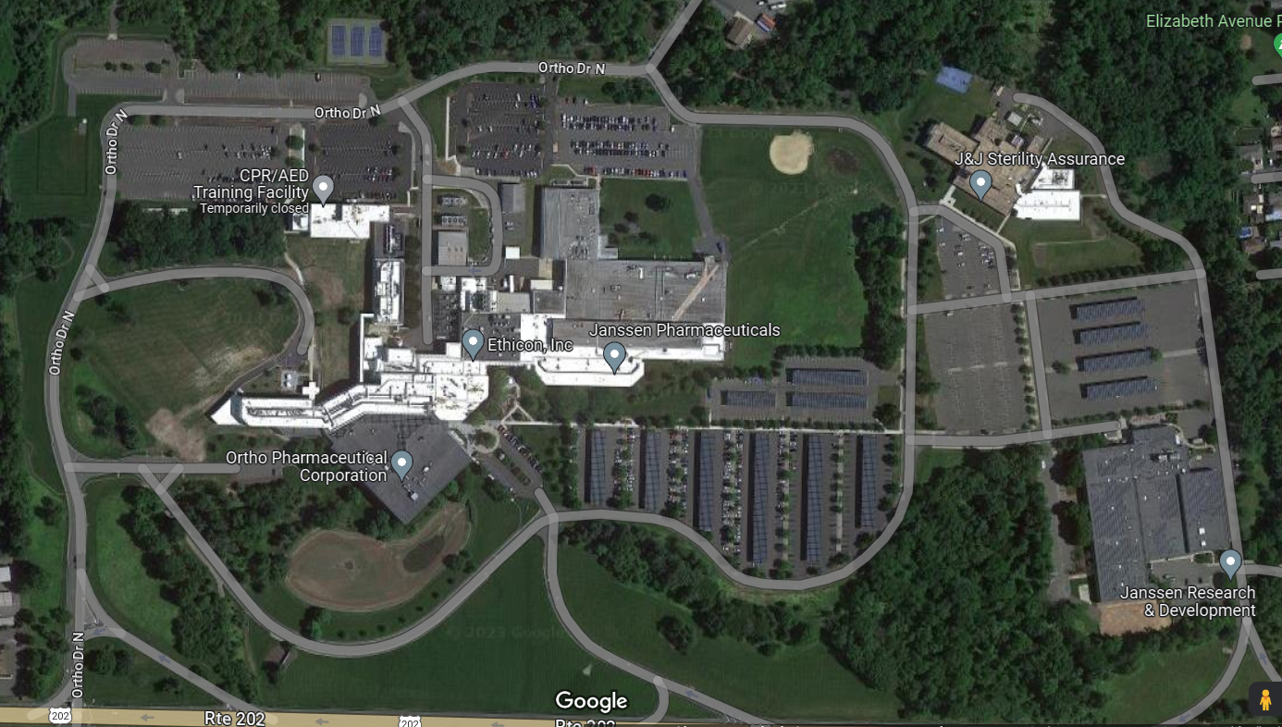
TCP N / JnJ Security
Parking
Overflow Parking
Registration Tents
Parking
EMS
Restrooms
K9 Demo
TCP E / JnJ Security
HLZ [1]
Water Station
Volunteer Parking
TCP W / JnJ Security
TCP S / JnJ Security
= Ground Marshall / Volunteer
= Traffic Control Point (TCP)
= Helicopter Landing Zone (HLZ)
Notes:
2024 Map (1.55 miles)
Parking lot at HLZ [1] is not for parking! Helicopter will be landing there!
After 8:30am all routes into site will be closed except TCP N entrance.

Slide 4
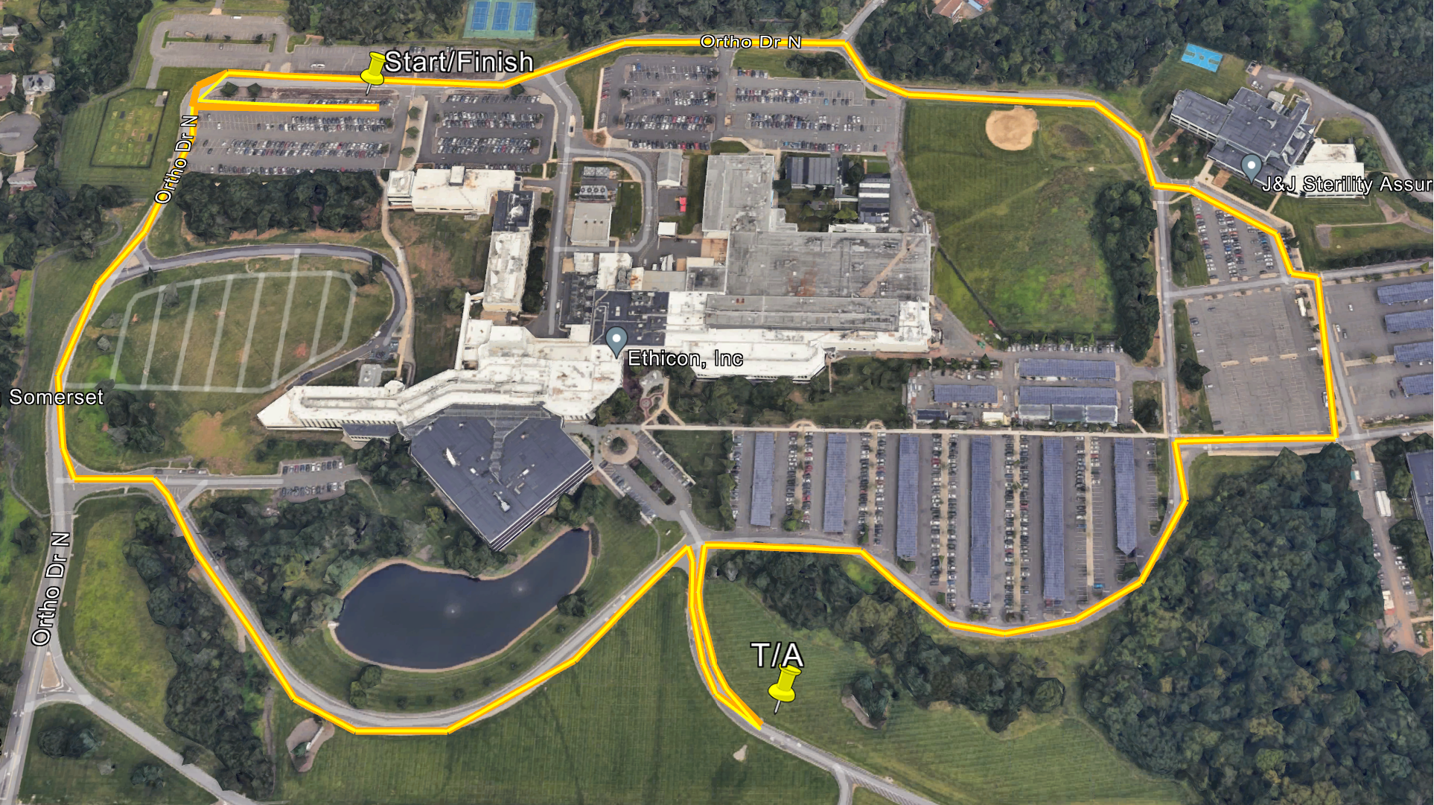
Notes:
*All 1 Mile Runners/Ruck will do only 1 lap around the course. 5K Runners/Rucks will do 2 laps.*

Slide 5
The Royal
Address: 3331 US-22, Branchburg, NJ 08876
*The Royal is about 10 minutes away from the JnJ Raritan Campus*
For more information on HOME of Somerset County, INC. see their website: HOME

Slide 6
On Race Day, please sign on of the Veterans Day Cards at the registration tent.
These cards will be delivered to Veterans at the
Menlo Park Veterans Memorial Home in Edison, NJ on Veterans Day.

