Slide 1
Participant enter
and exit parking here
P
Participant parking lots
1
Packet Pickup
P
2
Podium / Sound system
(on grass median)
Enter/Exit Parking here
3
i3 Cares Tent / Water station
P
NO PARKING
Emergency Vehicle Access
4
TMF Tent
No personal vehicles
5
Fleet Feet Tent
9
8
6
Food Truck
7
4
6
1
7
Food Truck
Volunteer/Sponsor Parking Only
5
2
8
Harmon Scrap Metal Tent
3
Yellowhammer Roofing Tent
9
Start/Finish Line
Porta Potty
Run route (next slide)
Emergency Vehicle Parking
Vehicle barriers

Slide 2
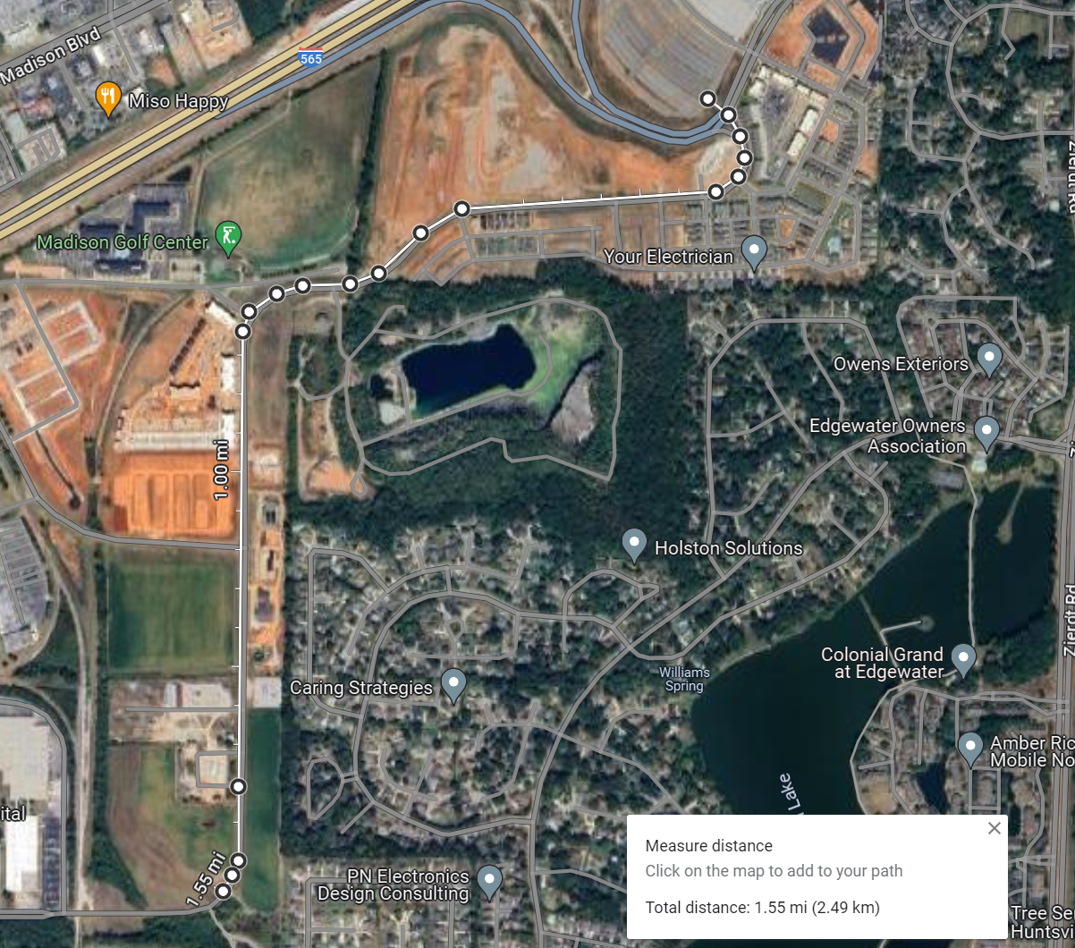
See previous slide for detailed map of parking area, Start/Finish line
P
P
Park at Toyota Field (exact location is TBD)
Start/Finish Line
Turn Around @ 1.55mi mark.
Total course length = 3.1mi

